Slide 1
Graphs and Trees
Course Code: CSC 2211
Course Title: Algorithms
Dept. of Computer Science
Faculty of Science and Technology
Lecturer No: |  | Week No: | 10 | Semester: | Spring 2019-2020
Lecturer: | Name & email

Slide 2
Lecture Outline
Graph Basics
Graph Searching
Depth First Search
Breadth First Search
Topological Sort

Slide 3
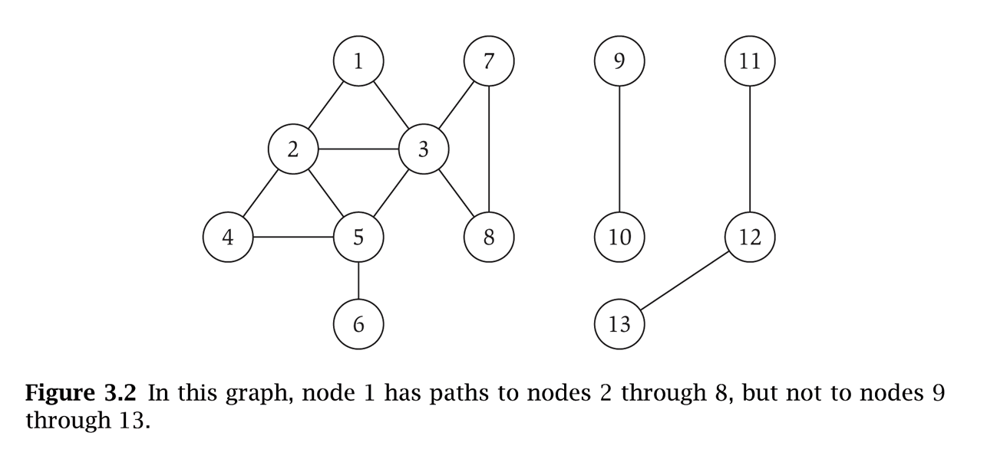
Graphs
Graph – mathematical object consisting of a set of:
V = nodes (vertices, points).
E = edges (links, arcs) between pairs of nodes.
Denoted by G = (V, E).
Captures pair wise relationship between objects.
Graph size parameters: n = |V|, m = |E|.
V = { 1, 2, 3, 4, 5, 6, 7, 8 }
E = { {1,2}, {1,3}, {2,3}, {2,4}, {2,5}, {3,5}, {3,7}, {3,8}, {4,5}, {5,6} } n = 8
m = 11

Slide 4
Graphs
Undirected Graph: A graph whose edges are unordered pairs of vertices. That is, each edge connects two vertices where edge (u, v) = edge (v, u).
Directed Graph: A graph whose edges are ordered pairs of vertices. That is, each edge can be followed from one vertex to another vertex where edge (u, v) goes from vertex u to vertex v.
Acyclic Graph: A graph with no path that starts and ends at the same vertex.
1
2
1
2
1
2
3
4
3
4
3
4
Directed
graph
Undirected
graph
Acyclic
graph

Slide 5
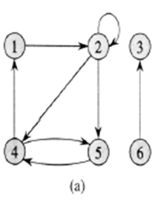
Graph Example
A directed graph G= (V, E), where V = {1, 2, 3, 4, 5, 6} and E={ (1,2), (2,2), (2,4), (2,5), (4,1), (4,5), (5,4), (6,3) }. The edge (2,2) is self loop. Vertex 5 has in-degree 2 and out-degree 1. Vertex 4 is adjacent to vertex 5; {1, 5} is adjacent to 4; 3 is not adjacent to any other vertex except 6.

Slide 6
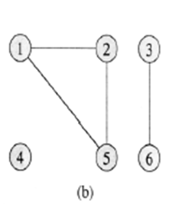
Graph Example
An undirected graph G = (V, E), where V = {1, 2, 3, 4, 5, 6} and E = { {1,2}, {1,5}, {2,5}, {3,6}}. The vertex 4 is isolated. Vertex 1, 2, 5 has degree 2; vertex 3, 6 has degree 1; vertex 4 has degree 0. Vertex 3 is adjacent to vertex 6 and vice versa; {1, 5} is adjacent to 2; 4 is not adjacent to any other vertex.

Slide 7
Graph Introduction
Complete graph: When every vertex is strictly connected to each other. (The number of edges in the graph is maximum).
Degree of a vertex v: The degree of vertex v in a graph G, written d (v ), is the number of edges incident to v, except that each loop at v counts twice (in-degree and out-degree for directed graphs)
_{A}
_{B}
_{F}
_{C}
_{E}
_{D}
d(A)=3, d(B)=3,d(C)=2
d(D)=3, d(E)=3,d(F)=2
Complete Graph

Slide 8
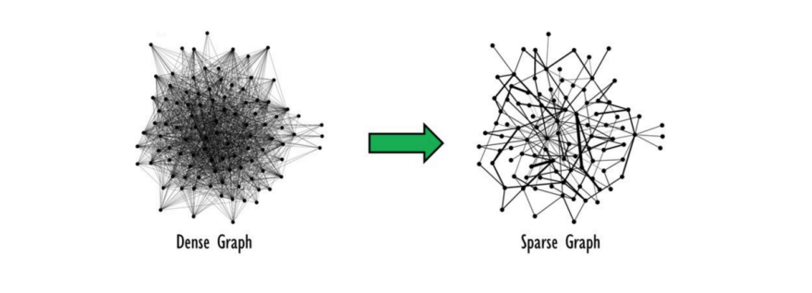
Graph Introduction
Dense graph: When the number of edges in the graph is close to maximum. (adjacency matrix is used to store info for this)
Sparse graph: When number of edges in the graph is very few. (adjacency list is used to store info for this)
Notes:
A dense graph is one where there are many edges, but not necessarily as many as in a complete graph. This term is intentionally vague and is intended to convey a general sense that the number of edges can be expected to be large with respect to the number of vertices.

Slide 9
Graph Introduction
Weighted graph: associates weights with either the edges or the vertices
DAG: Directed acyclic graphs
Connected: if every vertex of a graph can reach every other vertex, i.e., every pair of vertices is connected by a path
Strongly connected: every 2 vertices are reachable from each other (in a digraph)
Connected Component: equivalence classes of vertices under “is reachable from” relation. Simply put, it is a subgraph in which any two vertices are connected to each other by paths, and which is connected to no additional vertices in the supergraph.

Slide 10
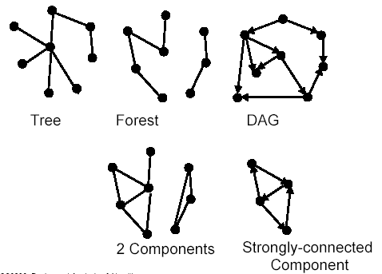
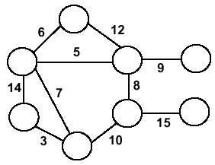
Forests, DAG, Components
Weighted Graph

Slide 11
Graph Applications
State-space search in Artificial Intelligence
Geographical information systems, electronic street directory
Logistics and supply chain management
Telecommunications network design
Many more industry applications
The graphic representation of world wide web (www)
Resource allocation graph for processes that are active in the system.
The graphic representation of a map
Scene graphs: The contents of a visual scene are also managed by using graph data structure.

Slide 12
Applications—Communication Network
2
3
8
1
10
4
5
9
11
6
7
Vertex = city, edge = communication link.

Slide 13
Applications—Driving Distance/Time Map
2
4
3
8
8
1
6
10
2
4
5
4
4
3
5
9
11
5
6
6
7
7
Vertex = city, edge weight = driving distance/time.

Slide 14
Applications—Street Map
2
3
8
1
10
4
5
9
11
6
7
Some streets are one way.

Slide 15
Graph Representation
Adjacency matrix: represents a graph as n x n matrix A (here, n is the number of nodes/ vertices):
A[i, j] = 1 if edge (i, j) ∈ E (or weight of edge)
= 0 if edge (i, j) ∉ E
Storage requirements: O(n²)
Using adjacency matrix is more efficient to represent dense graphs
Especially if store just one bit/edge
Undirected graph: only need half of matrix

Slide 16
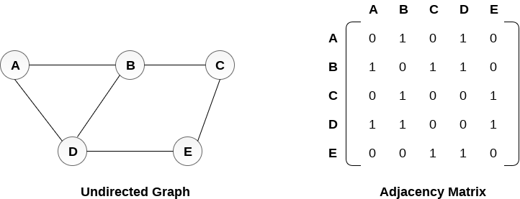
Graph Representation
(a)
(b)
a. An undirected graph G having five vertices and six edges.
b. The adjacency-matrix representation of G.

Slide 17
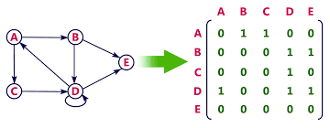
Graph Representation
(a)
(b)
a. A directed graph G having five vertices and eight edges.
b. The adjacency-matrix representation of G.

Slide 18
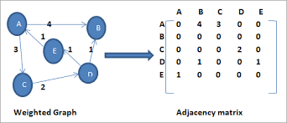
Graph Representation
(a)
(b)
a. A directed weighted graph G having five vertices and six edges.
b. The adjacency-matrix representation of G.

Slide 19
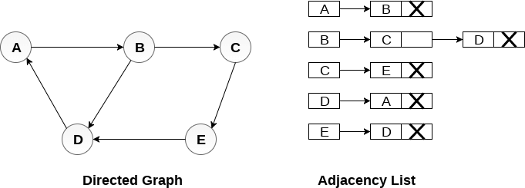
Graph Representation
Adjacency list: list of adjacent vertices. For each vertex v ∈ V, store a list of vertices adjacent to v
Storage requirements: O(n+e)
Using adjacency list is more efficient to represent sparse graphs
(a)
(b)
a. A directed graph G having five vertices and six edges.
b. The adjacency-list representation of G.

Slide 20
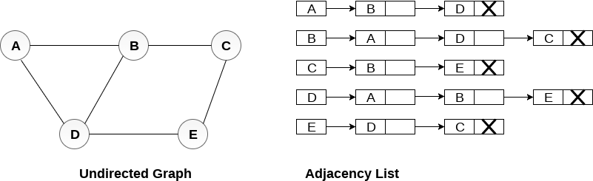
Graph Representation
(a)
(b)
a. An undirected graph G having five vertices and six edges.
b. The adjacency-list representation of G.

Slide 21
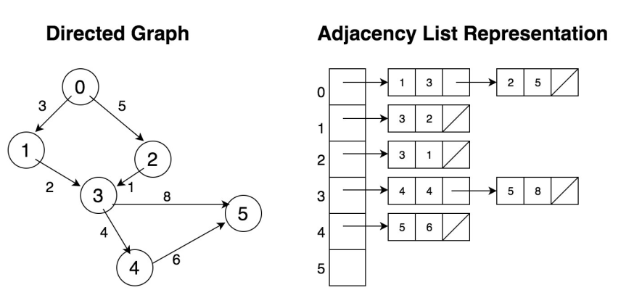
Graph Representation
(a)
(b)
a. A directed weighted graph G having six vertices and seven edges.
b. The adjacency-list representation of G.

Slide 22
Graph Searching
Given: a graph G = (V, E), directed or undirected
Goal: methodically explore every vertex and edge
Ultimately: build a tree on the graph
Pick a vertex as the root
Choose certain edges to produce a tree
Note: might also build a forest if graph is not connected
Breadth-first search
Depth-first search
Other variants: best-first, iterated deepening search, etc.

Slide 23
Depth-First Search (DFS)
Explore “deeper” in the graph whenever possible
Edges are explored out of the most recently discovered vertex v that still has unexplored edges (LIFO)
When all of v’s edges have been explored, backtrack to the vertex from which v was discovered
computes 2 timestamps: d[ ] (discovered) and f[ ] (finished)
builds one or more depth-first tree(s) (depth-first forest)
Algorithm colors each vertex
WHITE: undiscovered
GRAY: discovered, in process
BLACK: finished, all adjacent vertices have been discovered

Slide 24
Depth-First Search: The Code
DFS(G)
{
for each vertex u V
color[u] = WHITE;
time = 0;
for each vertex u V
if (color[u] == WHITE)
DFS_Visit(u);
}
DFS_Visit(u)
{
color[u] = GREY;
time = time+1;
d[u] = time; // compute d[]
for each v adjacent to u
if (color[v] == WHITE)
p[v]= u // build tree
DFS_Visit(v);
color[u] = BLACK;
time = time+1;
f[u] = time; // compute f[]
}

Slide 25
DFS Classification of Edges
DFS can be used to classify edges of G:
Tree edges: edges in the depth-first forest.
Back edges: edges (u, v) connecting a vertex u to an ancestor v in a depth-first tree.
Forward edges: non-tree edges (u, v) connecting a vertex u to a descendant v in a depth-first tree.
Cross edges: all other edges.
DFS yields valuable information about the structure of a graph.

Slide 26
Operations of DFS
u
v
w
Undiscovered
Discovered, On Process
Finished, all adjacent vertices have been discovered
x
y
z
Discover time/ Finish time

Slide 27
Operations of DFS
u
u
v
v
w
w
Undiscovered
1/
Discovered, On Process
Finished, all adjacent vertices have been discovered
x
x
y
y
z
z
Discover time/ Finish time

Slide 28
Operations of DFS
u
u
u
v
v
v
w
w
w
Undiscovered
1/
1/
2/
Discovered, On Process
Finished, all adjacent vertices have been discovered
x
y
z
x
x
y
y
z
z
Tree edge
Discover time/ Finish time

Slide 29
Operations of DFS
u
u
u
u
v
v
v
v
w
w
w
w
Undiscovered
1/
1/
1/
2/
2/
Discovered, On Process
Finished, all adjacent vertices have been discovered
3/
x
y
z
x
x
x
y
y
y
z
z
z
Tree edge
Discover time/ Finish time

Slide 30
Operations of DFS
u
u
u
u
u
v
v
v
v
v
w
w
w
w
w
Undiscovered
1/
1/
1/
1/
2/
2/
2/
Discovered, On Process
4/
3/
Finished, all adjacent vertices have been discovered
3/
x
y
z
x
x
x
x
y
y
y
y
z
z
z
z
Tree edge
Discover time/ Finish time

Slide 31
Operations of DFS
u
u
u
u
u
u
v
v
v
v
v
v
w
w
w
w
w
w
Undiscovered
1/
1/
1/
1/
1/
2/
2/
2/
2/
Discovered, On Process
4/
3/
4/
3/
Finished, all adjacent vertices have been discovered
3/
x
y
z
x
y
z
x
x
x
x
y
y
y
y
z
z
z
z
Tree edge
Back Edge
Discover time/ Finish time

Slide 32
Operations of DFS
u
u
u
u
u
u
u
v
v
v
v
v
v
v
w
w
w
w
w
w
w
Undiscovered
1/
1/
1/
1/
1/
1/
2/
2/
2/
2/
2/
Discovered, On Process
4/
3/
4/
4/5
3/
3/
Finished, all adjacent vertices have been discovered
3/
x
y
z
x
y
z
x
x
x
x
x
y
y
y
y
y
z
z
z
z
z
Tree edge
Back Edge
Discover time/ Finish time

Slide 33
Operations of DFS
u
u
u
u
u
u
u
u
v
v
v
v
v
v
v
v
w
w
w
w
w
w
w
w
Undiscovered
1/
1/
1/
1/
1/
1/
1/
2/
2/
2/
2/
2/
2/
Discovered, On Process
4/
3/
4/
4/5
4/5
3/
3/
3/
Finished, all adjacent vertices have been discovered
3/6
x
y
z
x
y
z
x
x
x
x
x
x
y
y
y
y
y
y
z
z
z
z
z
z
Tree edge
Back Edge
Discover time/ Finish time

Slide 34
Operations of DFS
u
u
u
u
u
u
u
u
u
v
v
v
v
v
v
v
v
v
w
w
w
w
w
w
w
w
w
Undiscovered
1/
1/
1/
1/
1/
1/
1/
1/
2/
2/
2/
2/
2/
2/
2/7
Discovered, On Process
4/
3/
4/
4/5
4/5
4/5
3/
3/
3/
3/6
Finished, all adjacent vertices have been discovered
3/6
x
y
z
x
y
z
x
x
x
x
x
x
x
y
y
y
y
y
y
y
z
z
z
z
z
z
z
Tree edge
Back Edge
Discover time/ Finish time

Slide 35
Operations of DFS
u
u
u
u
u
u
u
u
u
u
u
v
v
v
v
v
v
v
v
v
v
v
w
w
w
w
w
w
w
w
w
w
w
Undiscovered
1/
1/
1/
1/
1/
1/
1/
1/
1/
1/8
2/
2/7
2/
2/
2/
2/
2/
2/7
2/7
Discovered, On Process
4/
3/
4/5
3/6
4/
4/5
4/5
4/5
4/5
3/
3/
3/
3/6
3/6
Finished, all adjacent vertices have been discovered
3/6
x
y
z
x
y
z
x
y
z
x
x
x
x
x
x
x
x
y
y
y
y
y
y
y
y
z
z
z
z
z
z
z
z
Tree edge
Back Edge
Discover time/ Finish time
Forward Edge

Slide 36
Operations of DFS
u
u
u
u
u
u
u
u
u
u
u
v
v
v
v
v
v
v
v
v
v
v
w
w
w
w
w
w
w
w
w
w
w
Undiscovered
1/
1/8
1/
1/
1/
1/
1/
1/
1/
1/8
2/
2/7
2/
2/
2/
2/
2/
2/7
2/7
Discovered, On Process
4/
3/
4/5
3/6
4/
4/5
4/5
4/5
4/5
3/
3/
3/
3/6
3/6
Finished, all adjacent vertices have been discovered
3/6
x
y
z
x
y
z
x
y
z
x
x
x
x
x
x
x
x
y
y
y
y
y
y
y
y
z
z
z
z
z
z
z
z
Tree edge
Back Edge
Discover time/ Finish time
Forward Edge

Slide 37
Operations of DFS
u
u
u
u
u
u
u
u
u
u
u
u
v
v
v
v
v
v
v
v
v
v
v
v
w
w
w
w
w
w
w
w
w
w
w
w
Undiscovered
1/
1/8
1/
1/
1/
1/
1/
1/
1/
1/8
1/8
2/
2/7
2/
2/
2/
2/
2/
2/7
2/7
2/7
9/
Discovered, On Process
4/
3/
4/5
3/6
4/
4/5
4/5
4/5
4/5
4/5
3/
3/
3/
3/6
3/6
3/6
Finished, all adjacent vertices have been discovered
3/6
x
y
z
x
y
z
x
y
z
x
x
x
x
x
x
x
x
x
y
y
y
y
y
y
y
y
y
z
z
z
z
z
z
z
z
z
Tree edge
Back Edge
Discover time/ Finish time
Forward Edge

Slide 38
Operations of DFS
u
u
u
u
u
u
u
u
u
u
u
u
u
v
v
v
v
v
v
v
v
v
v
v
v
v
w
w
w
w
w
w
w
w
w
w
w
w
w
Undiscovered
1/
1/8
1/
1/8
1/
1/
1/
1/
1/
1/
1/8
1/8
2/
2/7
2/
2/7
2/
2/
2/
2/
2/7
2/7
2/7
9/
9/
Discovered, On Process
4/
3/
4/5
3/6
4/5
3/6
4/
4/5
4/5
4/5
4/5
4/5
3/
3/
3/
3/6
3/6
3/6
Finished, all adjacent vertices have been discovered
3/6
x
y
z
x
y
z
x
y
z
x
y
z
x
x
x
x
x
x
x
x
x
y
y
y
y
y
y
y
y
y
z
z
z
z
z
z
z
z
z
Tree edge
Back Edge
Discover time/ Finish time
Forward Edge
Cross Edge

Slide 39
Operations of DFS
u
u
u
u
u
u
u
u
u
u
u
u
u
u
v
v
v
v
v
v
v
v
v
v
v
v
v
v
w
w
w
w
w
w
w
w
w
w
w
w
w
w
Undiscovered
1/
1/8
1/
1/8
1/
1/
1/
1/
1/
1/
1/8
1/8
1/8
2/
2/7
2/
2/7
2/
2/
2/
2/
2/7
2/7
2/7
2/7
9/
9/
9/
Discovered, On Process
4/
3/
4/5
3/6
4/5
3/6
4/
4/5
4/5
4/5
4/5
4/5
4/5
3/
3/
3/
3/6
3/6
3/6
3/6
Finished, all adjacent vertices have been discovered
3/6
10/
x
y
z
x
y
z
x
y
z
x
y
z
x
x
x
x
x
x
x
x
x
x
y
y
y
y
y
y
y
y
y
y
z
z
z
z
z
z
z
z
z
z
Tree edge
Back Edge
Discover time/ Finish time
Forward Edge
Cross Edge

Slide 40
Operations of DFS
u
u
u
u
u
u
u
u
u
u
u
u
u
u
u
v
v
v
v
v
v
v
v
v
v
v
v
v
v
v
w
w
w
w
w
w
w
w
w
w
w
w
w
w
w
Undiscovered
1/
1/8
1/
1/8
1/8
1/
1/
1/
1/
1/
1/
1/8
1/8
1/8
2/
2/7
2/
2/7
2/7
2/
2/
2/
2/
2/7
2/7
2/7
2/7
9/
9/
9/
9/
Discovered, On Process
4/
3/
4/5
3/6
4/5
3/6
4/
4/5
4/5
4/5
4/5
4/5
4/5
4/5
3/6
3/
3/
3/
3/6
3/6
3/6
3/6
3/6
10/
Finished, all adjacent vertices have been discovered
10/
x
y
z
x
y
z
x
y
z
x
y
z
x
x
x
x
x
x
x
x
x
x
x
y
y
y
y
y
y
y
y
y
y
y
z
z
z
z
z
z
z
z
z
z
z
Tree edge
Back Edge
Discover time/ Finish time
Forward Edge
Cross Edge

Slide 41
Operations of DFS
u
u
u
u
u
u
u
u
u
u
u
u
u
u
u
u
v
v
v
v
v
v
v
v
v
v
v
v
v
v
v
v
w
w
w
w
w
w
w
w
w
w
w
w
w
w
w
w
Undiscovered
1/
1/8
1/
1/8
1/8
1/8
1/
1/
1/
1/
1/
1/
1/8
1/8
1/8
2/
2/7
2/
2/7
2/7
2/7
2/
2/
2/
2/
2/7
2/7
2/7
2/7
9/
9/
9/
9/
9/
Discovered, On Process
4/
3/
4/5
3/6
4/5
3/6
4/
4/5
4/5
4/5
4/5
4/5
4/5
4/5
4/5
3/6
3/6
3/
3/
3/
3/6
3/6
3/6
3/6
3/6
10/
10/11
Finished, all adjacent vertices have been discovered
10/
x
y
z
x
y
z
x
y
z
x
y
z
x
x
x
x
x
x
x
x
x
x
x
x
y
y
y
y
y
y
y
y
y
y
y
y
z
z
z
z
z
z
z
z
z
z
z
z
Tree edge
Back Edge
Discover time/ Finish time
Forward Edge
Cross Edge

Slide 42
Operations of DFS
u
u
u
u
u
u
u
u
u
u
u
u
u
u
u
u
u
v
v
v
v
v
v
v
v
v
v
v
v
v
v
v
v
v
w
w
w
w
w
w
w
w
w
w
w
w
w
w
w
w
w
Undiscovered
1/
1/8
1/
1/8
1/8
1/8
1/8
1/
1/
1/
1/
1/
1/
1/8
1/8
1/8
2/
2/7
2/
2/7
2/7
2/7
2/7
2/
2/
2/
2/
2/7
2/7
2/7
2/7
9/
9/
9/
9/12
9/
9/
Discovered, On Process
4/
3/
4/5
3/6
4/5
3/6
4/
4/5
4/5
4/5
4/5
4/5
4/5
4/5
4/5
4/5
3/6
3/6
3/6
3/
3/
3/
3/6
3/6
3/6
3/6
3/6
10/
10/11
10/11
Finished, all adjacent vertices have been discovered
10/
x
y
z
x
y
z
x
y
z
x
y
z
x
x
x
x
x
x
x
x
x
x
x
x
x
y
y
y
y
y
y
y
y
y
y
y
y
y
z
z
z
z
z
z
z
z
z
z
z
z
z
Tree edge
Back Edge
Discover time/ Finish time
Forward Edge
Cross Edge

Slide 43
DFS Analysis
Running time of DFS = O(n+e)
DFS (excluding DFS_Visit) takes O(n) time
DFS_Visit:
DFS_Visit( v ) is called exactly once for each vertex v
During DFS_Visit( v ), adjacency list of v is scanned once
sum of lengths of adjacency lists = O(e)
This type of aggregate analysis is an informal example of amortized analysis

Slide 44
Cycle Detection
Theorem: An undirected graph is acyclic iff a DFS yields no back edges
Proof
If acyclic, no back edges by definition (because a back edge implies a cycle)
If no back edges, acyclic
No back edges implies only tree edges (Why?)
Only tree edges implies we have a tree or a forest
Which by definition is acyclic
Thus, can run DFS to find whether a graph has a cycle.
How would you modify the code to detect cycles?

Slide 45
Topological Sort
Find a linear ordering of all vertices of the DAG such that if G contains an edge (u, v), u appears before v in the ordering.
In general, there may be many legal topological orders for a given DAG.
Idea:
Call DFS(G) to compute finishing time f[ ]
Insert vertices onto a linked list according to decreasing order of f[ ]
How to modify DFS to perform Topological Sort in O(n+e) time?

Slide 46
Topological Sort
A topological sort of a graph can be viewed as an ordering of its vertices along a horizontal line so that all directed edges go from left to right.

Slide 47
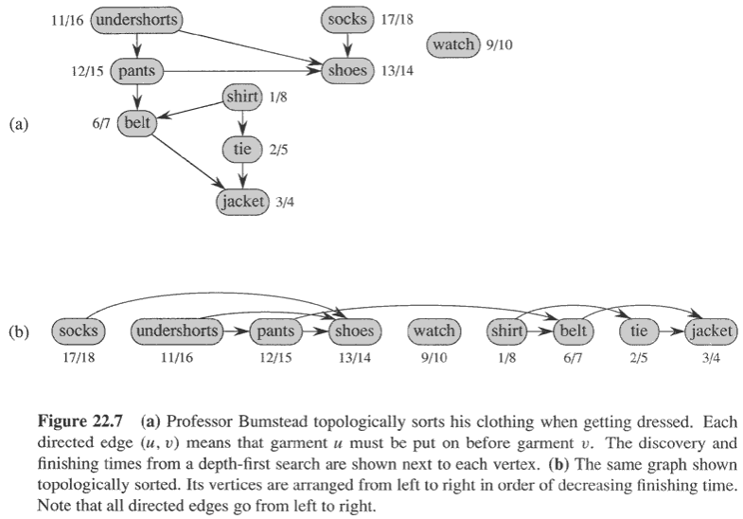
Topological Sort: Example

Slide 48
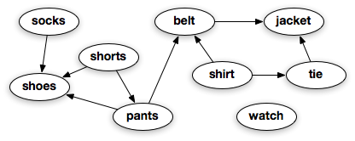
Things | Things to Wear Earlier
Socks | ……….
Shoes | Socks, Shorts, Pants
Sorts | ………
Pants | Shorts
Belts | Pants, Shirt
Shirt | ………..
Jacket | Belt, Tie
Tie | Shirt
Watch | …………..
Watch → Shirt → Tie → Shorts →Pants → Belt → Jacket → Socks → Shoes
Shirt → Tie → Watch → Socks → Shorts → Pants → Belt →Jacket → Shoes

Slide 49
Breadth-First Search (BFS)
Given source vertex s,
systematically explore the breadth of the frontier to
discover every vertex reachable from s
computes the distance d[ ] from s to all reachable vertices builds a breadth-first tree rooted at s
Algorithm
colors each vertex:
WHITE : undiscovered
GRAY: discovered, in process
BLACK: finished, all adjacent vertices have been discovered

Slide 50

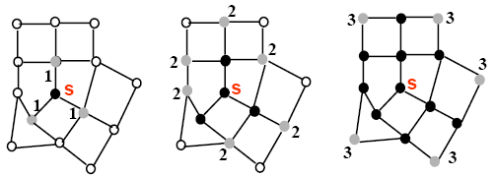
BFS (Intuition)

Slide 51
BFS: The Code
BFS(G, s) {
initialize vertices;
Q = {s};
while (Q not empty) {
u = Dequeue(Q);
for each v adjacent to u do {
if (color[v] == WHITE) {
color[v] = GRAY;
d[v] = d[u] + 1;// compute d[]
p[v] = u; // build BFS tree
Enqueue(Q, v);
}
}
color[u] = BLACK;
}
}

Slide 52
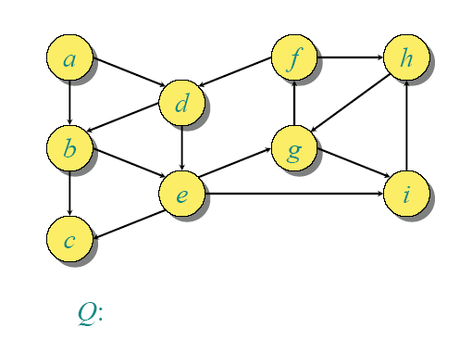
BFS Example

Slide 53
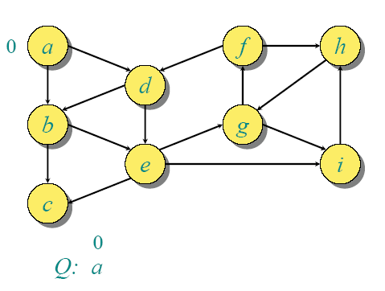
BFS Example

Slide 54
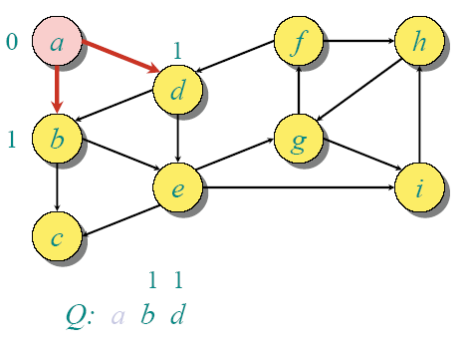
BFS Example

Slide 55
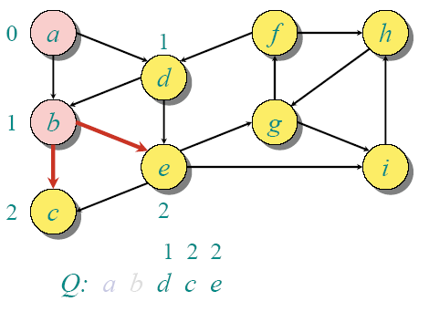
BFS Example

Slide 56
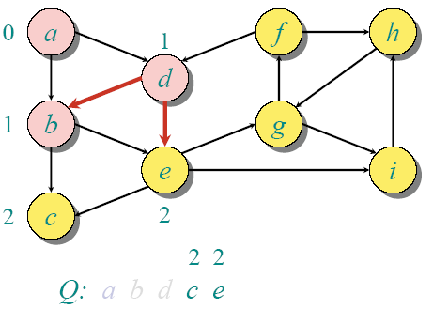
BFS Example

Slide 57
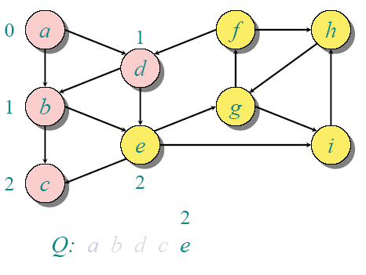
BFS Example

Slide 58
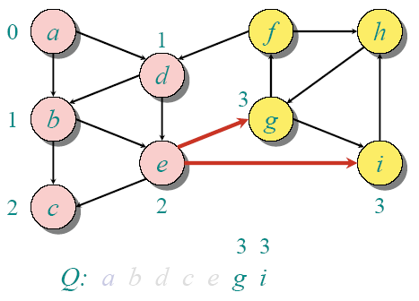
BFS Example

Slide 59
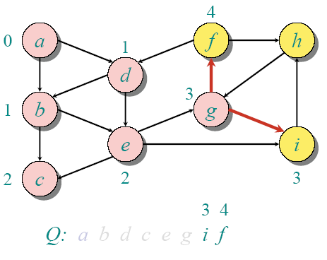
BFS Example

Slide 60
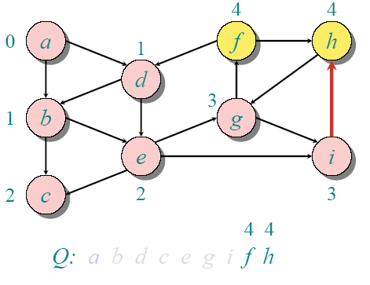
BFS Example

Slide 61
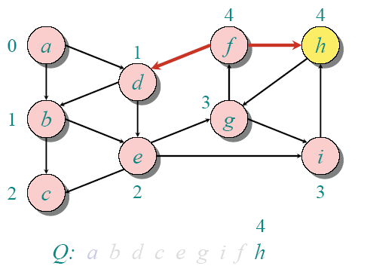
BFS Example

Slide 62
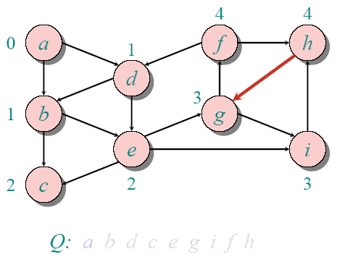
BFS Example

Slide 63
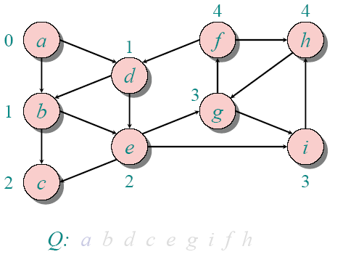
BFS Example

Slide 64
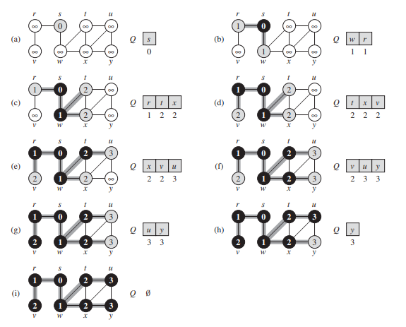

Slide 65
BFS Analysis
initialize : O(n)
Loop: Queue operations and Adjacency checks
Queue operations
each vertex is enqueued/dequeued at most once. Why?
each operation takes O(1) time, hence O(n)
Adjacency checks
adjacency list of each vertex is scanned at most once
sum of lengths of adjacency lists = O(e)
Total run time of BFS = O(n+e)

Slide 66
Breadth-First Search: Properties
What do we get the end of BFS?
d[v] = shortest-path distance from s to v, i.e. minimum number of edges from s to v, or ∞ if v not reachable from s
Proof : refer CLRS
a breadth-first tree, in which path from root s to any vertex v represent a shortest path
Thus can use BFS to calculate shortest path from one vertex to another in O(n+e) time, for unweighted graphs.

Slide 67
Books
Introduction to Algorithms, Third Edition, Thomas H. Cormen, Charle E. Leiserson, Ronald L. Rivest, Clifford Stein (CLRS).
Fundamental of Computer Algorithms, Ellis Horowitz, Sartaj Sahni, Sanguthevar Rajasekaran (HSR)

Slide 68
References
http://www.mathcs.emory.edu/~cheung/Courses/171/Syllabus/11-Graph/dfs.html
CLRS: 22.1, 22.2, 22.3, 22.4, 22.5
HSR: 2.2, 2.5

